Slide 1
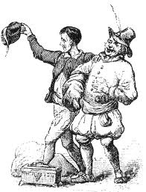
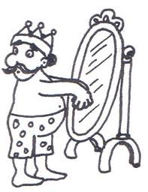
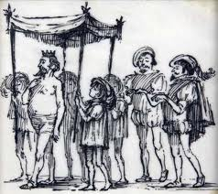
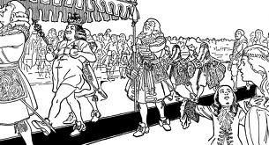
THE KING’S NEW SUIT
Once upon a time there was a very rich king. He spent all day in front of a mirror. He watched his new clothes every single time. One day two men arrived. The king wanted to speak to them. When they went to the palace the king asked them to make a new suit for him. The men said that they will make a suit for him but only clever people will see it. After a few days the suit was ready. The men saw to the king the suit. The king didn’t see anything and he was right, but pretended that it was brilliant and he said that he wanted to wear it to the next parade. The big day arrived. The king wore his new suit but in fact went to the parade without clothes. Suddenly a man shouted that the king isn’t wearing anything. The king was ashamed and understood that he was a fool after all.
Maria E.

