Slide 1
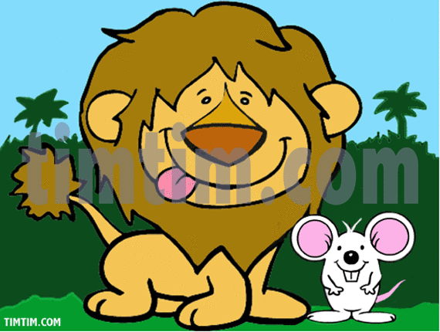
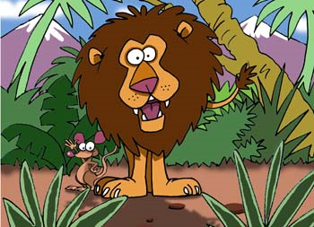
THE LION AND THE MOYSE
My favourite story is <<The Lion and the Mouse>>.Once upon a time there was a little white mouse which wanted to go swimming because the weather was very hot. In the road, she met a snake and his friends. The snake and his friends told her that she can wake the lion if she swam. But she swam and woke the lion. The lion told her to do anymore. After some days the mouse saved the lion trapped in a net and then they became friends. This story appealed to me because refers to animals.
MARIA NIMFOPOYLOY

